Slide 1
Artificial VS. Natural Selection
Chapter 16.1, 16.2, & 16.3 (p.380-391)

Slide 2
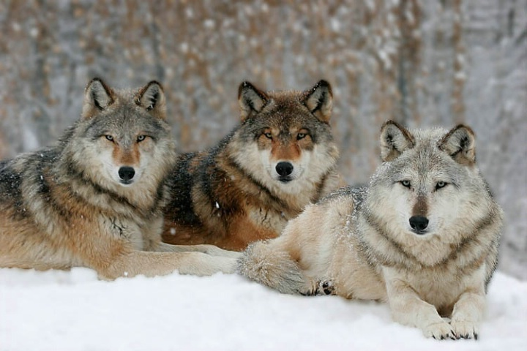

Slide 3
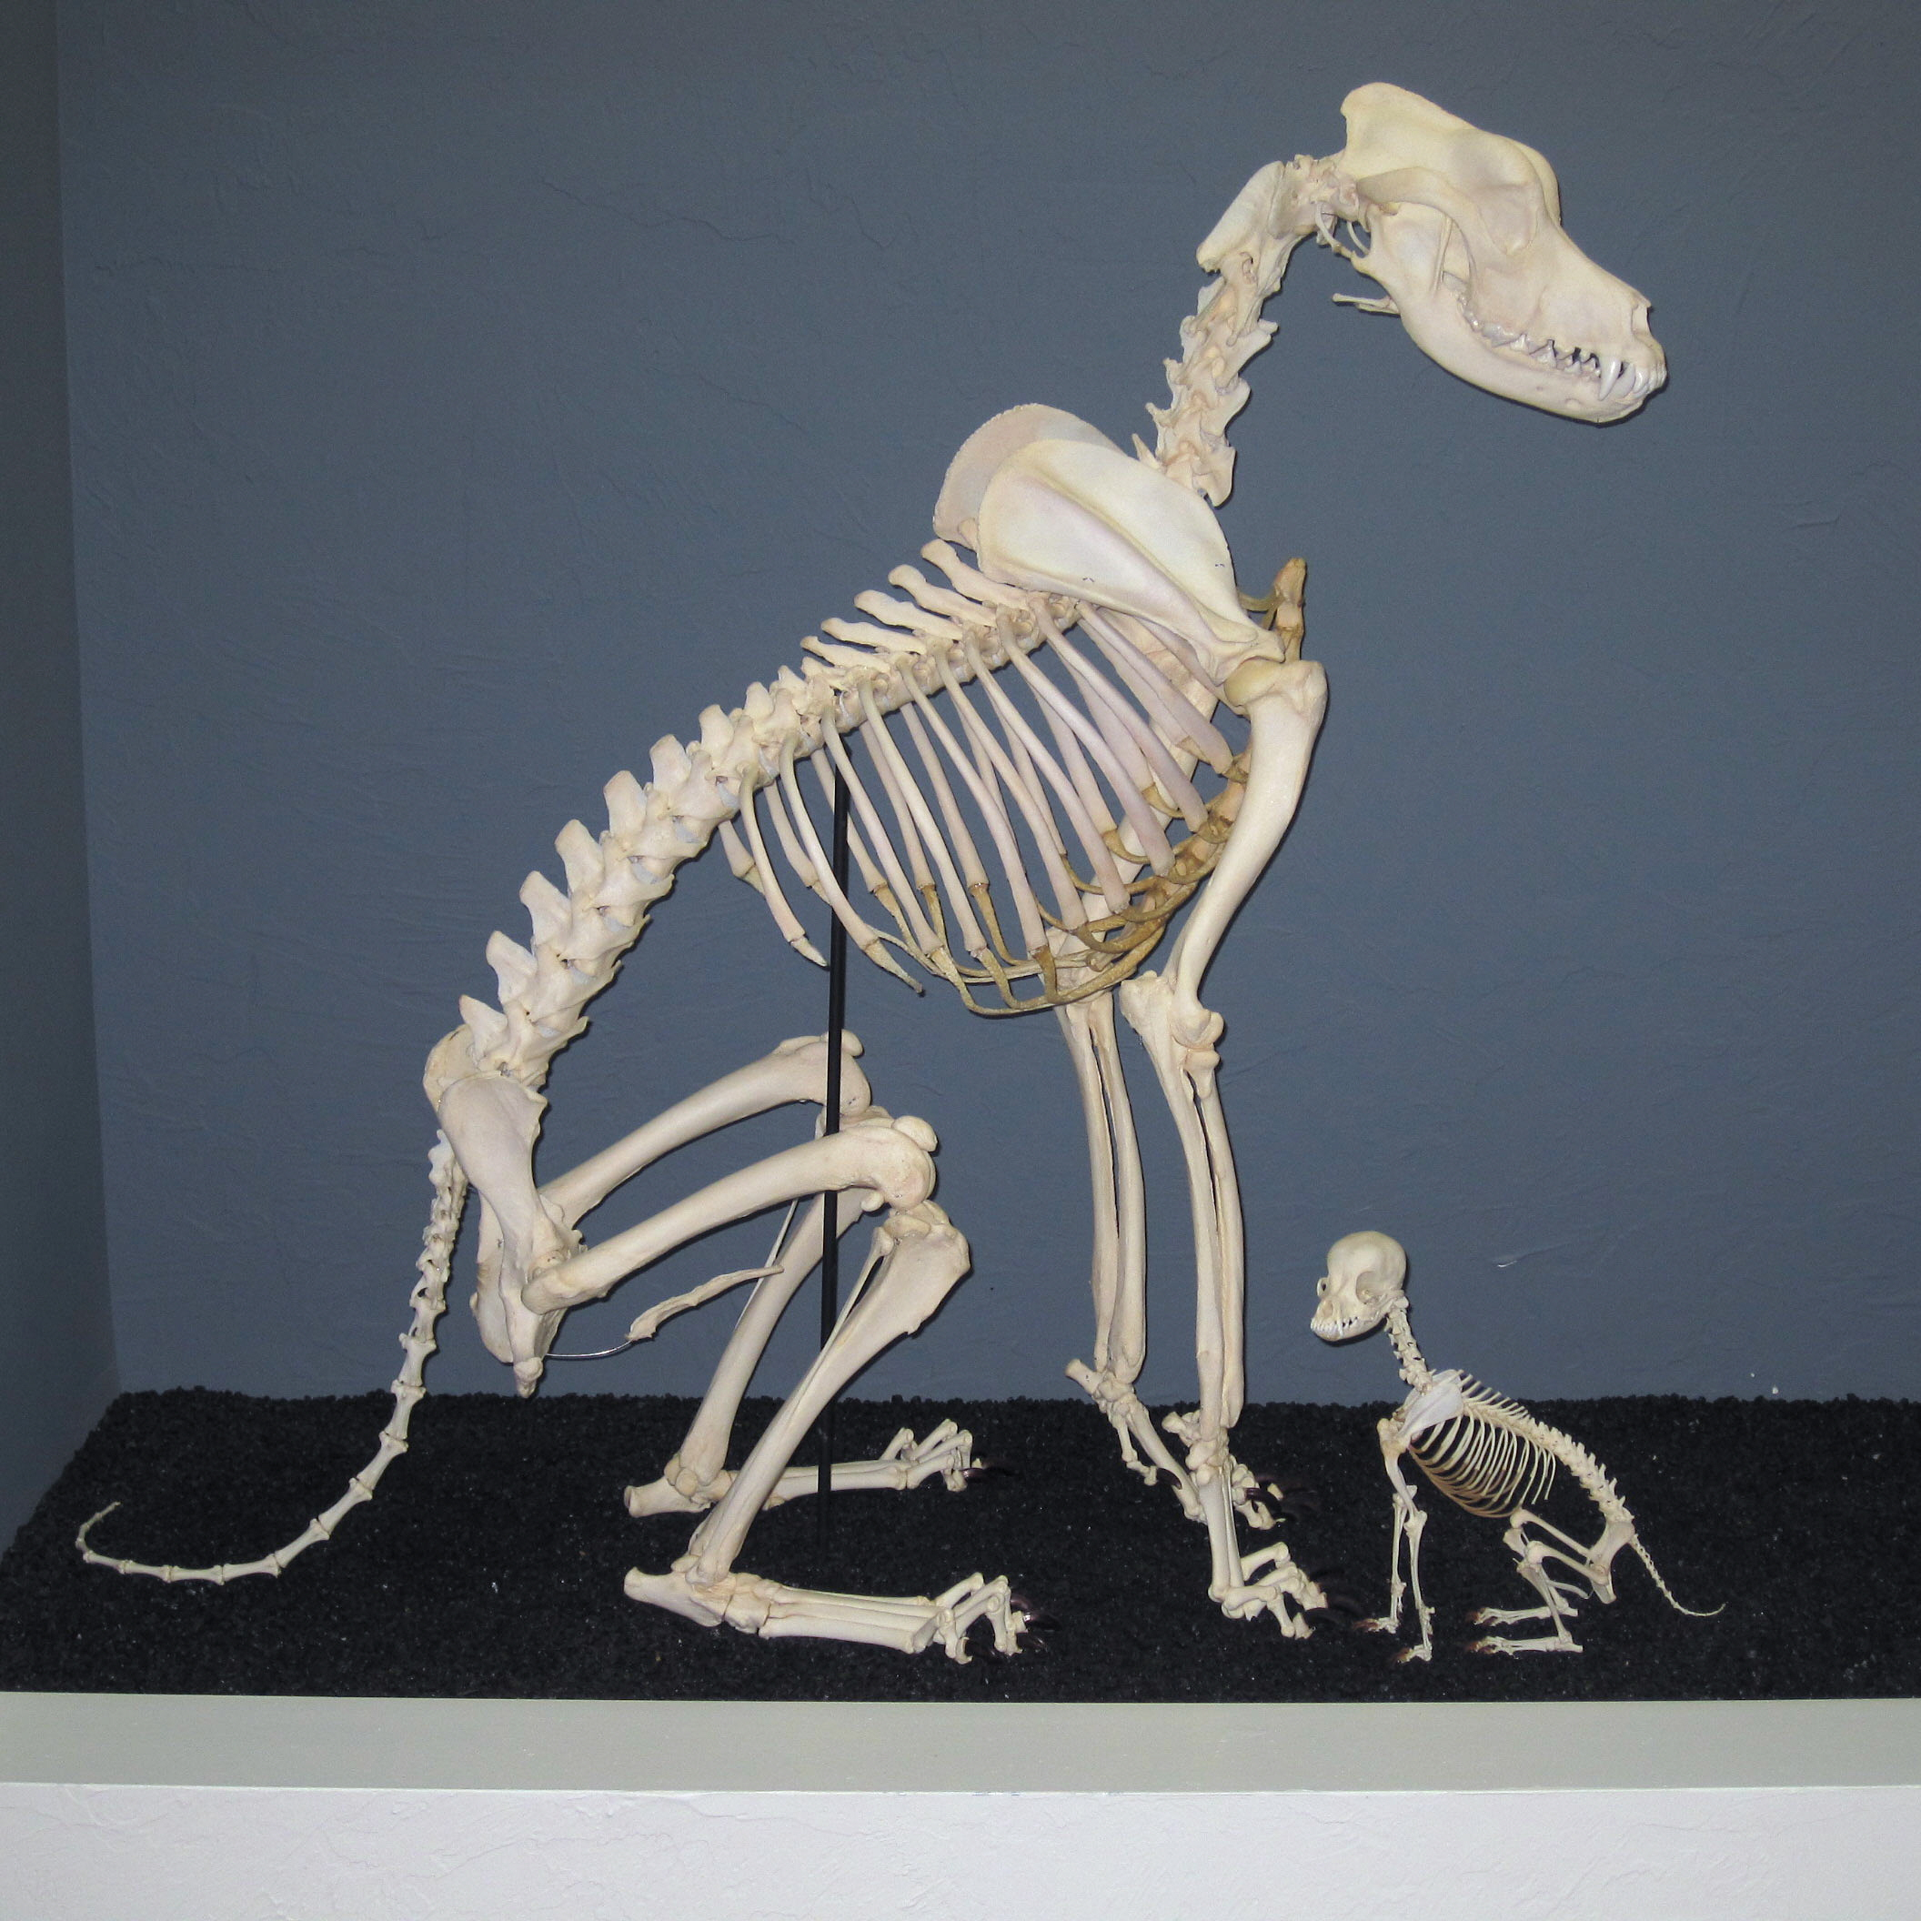

Slide 4
Natural Variation
Individuals vary in their genetic makeup in the natural world.
Sources of (random) variation
Mutations: Changes in nucleotide sequence during replication
Genetic drift: random changes in allele frequencies within a population
Gene flow: Immigration/emigration of new individuals who bring new allele frequencies
Sexual reproduction: Independent assortment of alleles during meiosis & fertilization

Slide 5
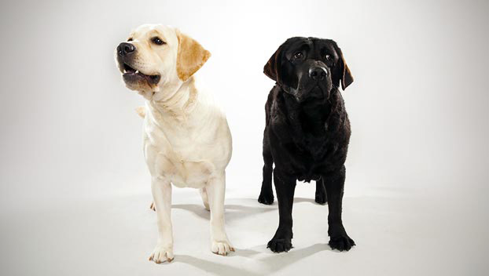
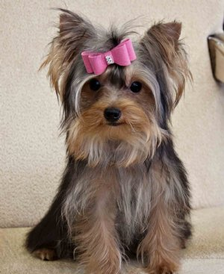
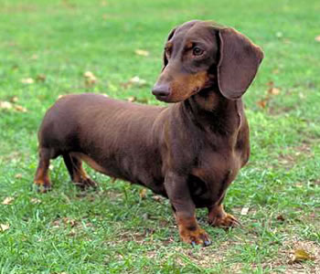
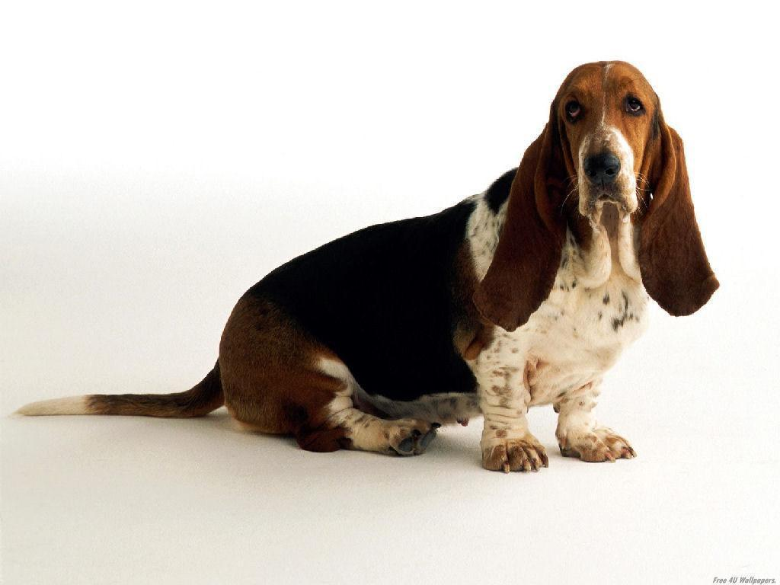
Artificial Selection
Humans take advantage of natural variation by
Determining which traits are “favorable” to us
Mating individuals with “favorable” traits

Slide 6
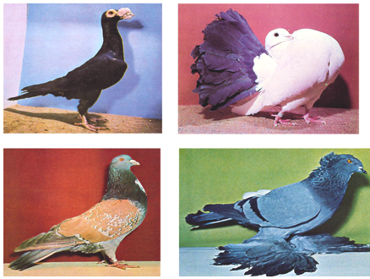
Artificial Selection in Other Animals

Slide 7
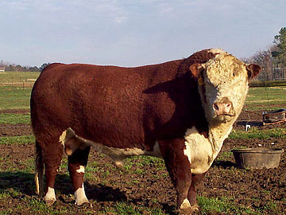
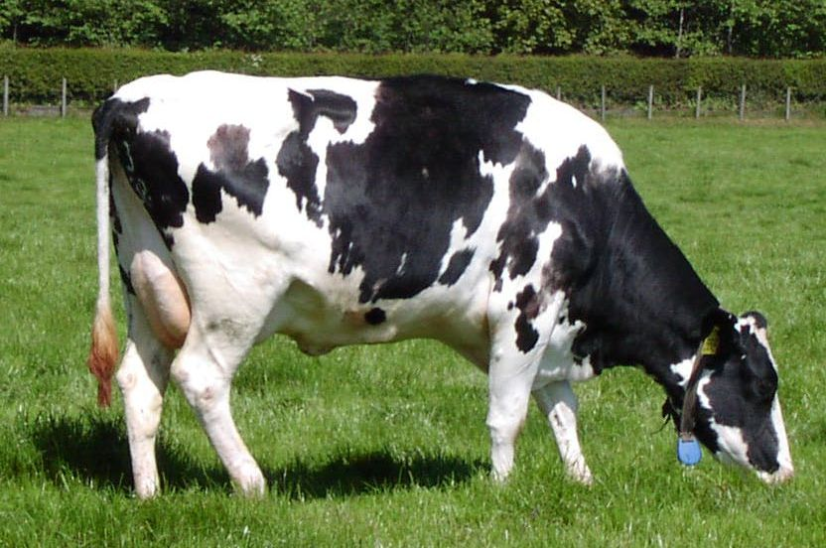
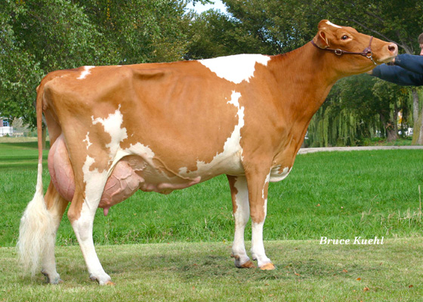
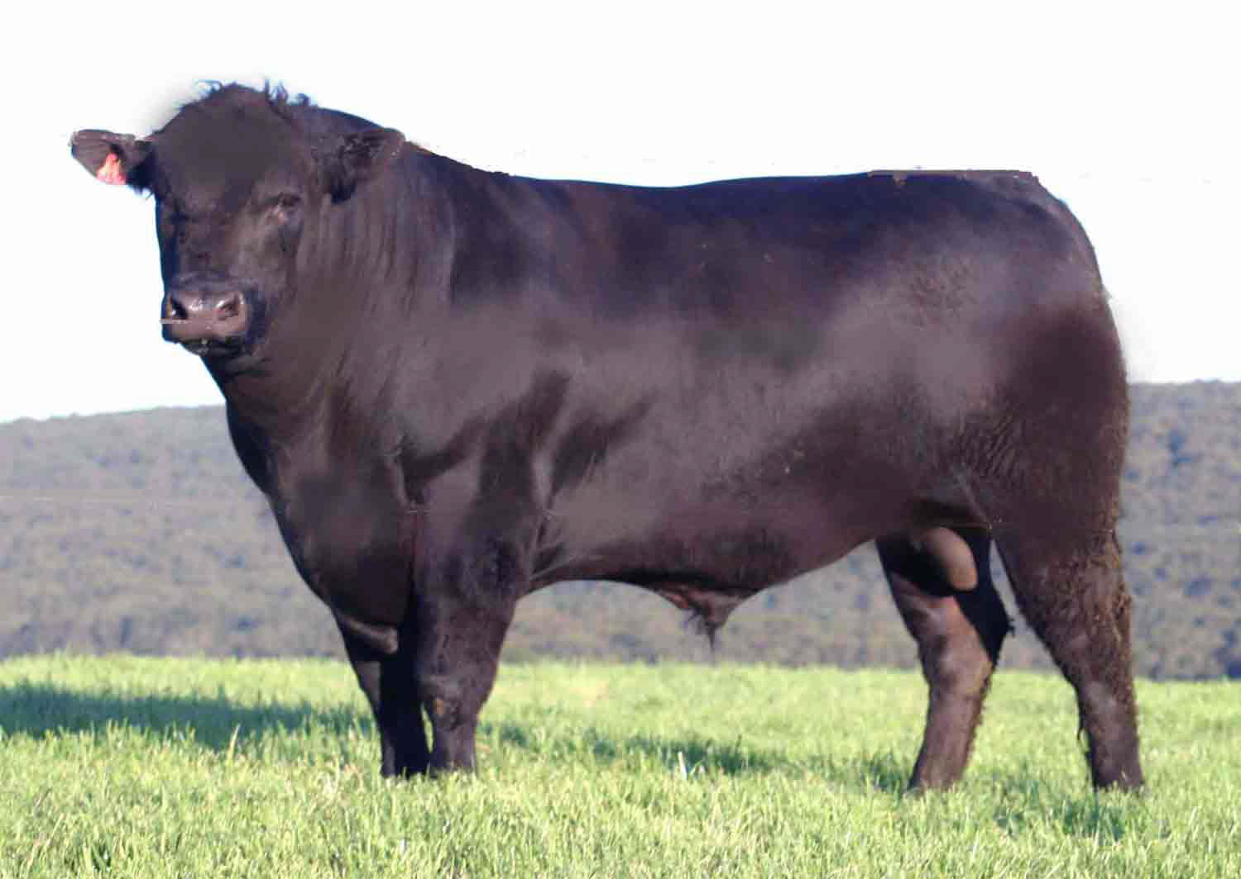
Artificial Selection in Other Animals

Slide 8
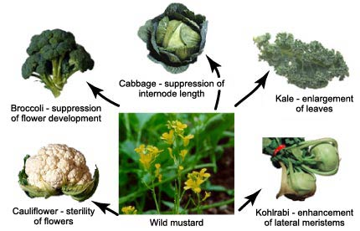
Artificial Selection in Crops

Slide 9
Natural Selection
Genetic variation exists within a population.
Some individuals will reproduce, while others will not.
Those with favorable phenotypes/genotypes in the environment tend to survive and reproduce more
Selective pressure (typically environmental) determines this
Those who are better suited to environment more likely to survive and reproduce, passing on their alleles (traits) to offspring.
Over generations, the allele (trait) frequency shifts within the population.

Slide 10
Natural Selection
Individuals within a population vary in their heritable traits.
(sources of variation: mutation, sexual reproduction, gene flow, genetic drift)
In the specific environment the population exists in, competition between individuals will determine who survives and reproduces and who does not.
Those with traits that enable them to compete and survive in their environment tend to reproduce more.
Those with traits that don’t enable them to compete and survive in their environment tend to reproduce less.
Individuals who reproduce pass on their genes (and traits) to their offspring.
After one or more generations living under the same environmental pressures, the frequency of traits within the population shifts.
More individual organisms now express the more “favorable” trait that allows them to compete, survive, and reproduce within the environment.

Slide 11
Wolves → Proto-dog
Individuals within the wolf population have heritable variations in size, aggression, intelligence, flight distance.
After humans settle into villages and dispose of animal carcasses and waste in dumps, competition between individuals will determine who survives and reproduces and who does not.
Those individuals that are smaller, less aggressive, less intelligent, and with shorter flight distance are unable to compete for a position in a wolf pack, are attracted to the dumps, survive and reproduce close to human settlements.
Those individuals that are larger, more aggressive, more intelligent, and with longer flight distance are able to compete for a position in a wolf pack, are not attracted to the dumps and do not survive and reproduce close to human settlements.
Wolves who reproduce close to human settlements pass on their genes (and traits) to their offspring.
After one or more generations with access to dumps, the frequency of traits within the population of wolves living close to human settlements shifts.
More wolves living close to human settlements are now smaller, less aggressive, less intelligent, and with shorter flight distances because this is the more “favorable” trait that allowed their parents to compete, survive, and reproduce within the environment.

Slide 12
Proto-dog → Domesticated Dog
Individuals within the proto-dog population have heritable variations in types of vocalization.
Humans realize that those individuals that are able to bark (and bark loudest) are best at warning them of attack from neighboring tribes.
Those individuals that bark more and loudest are chosen to mate together.
Those individuals that do not bark or bark more quietly are killed.
The individuals that are allowed to reproduce pass on their genes (and traits) to their offspring.
After one or more generations of selective breeding, the frequency of traits within the population of proto-dogs living amongst humans shifts. Other traits begin to show increased variation (coat color, ear shape, etc.) because these genes are linked to the gene that controls vocalization.
More proto-dogs are now able to bark or bark more loudly because this trait is considered to be most “favorable” by humans.

Slide 13
Light → Dark Fur
Individuals within the mouse population have heritable variations in coat color.
After a volcanic eruption changes the color of the rocks, competition between individuals will determine who survives and reproduces and who does not.
Those individuals with dark coats are better camouflaged against the dark rock of the lava flow, survive and reproduce.
Those individuals with light coats stand out against the dark rock of the lava flow, are caught more frequently by predators and do not reproduce.
Mice with dark coats pass on their dominant genes/allele(s) for their dark coat to their offspring.
After one or more generations living on the volcanic rock, the frequency of traits within the population of mice shifts.
More mice living on the volcanic rock have dark coats because this is the more “favorable” trait that allowed their parents to compete, survive, and reproduce within this environment.

